Slide 1
Duncan, Arizona Highway and Levee Alignment
Ashley Charlton, Leslie Sorenson, Morty Jim
Client: Phil Ronnerud, Greenlee County Engineer
Technical Advisor: Brendan Russo, PhD
Grader: Mark Lamer, PE
CENE 486C- 12/7/2018
Notes:
Introduce: Ashley

Slide 2
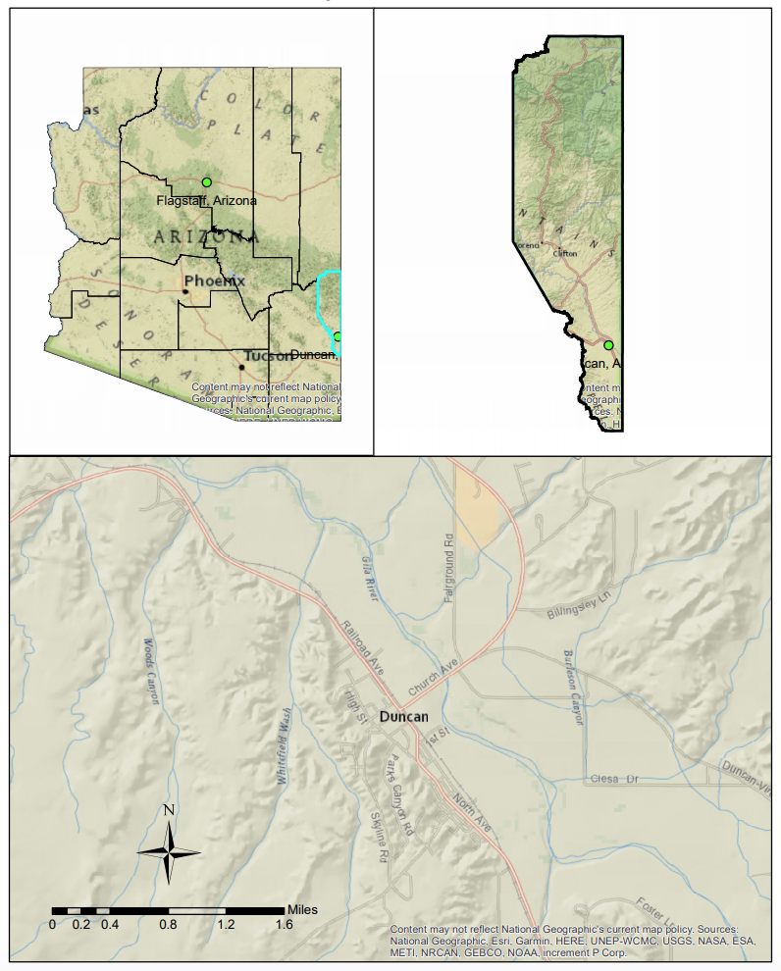
This project has been going on for 4 years
  Year 1: Floodplain Analysis 1-D Model and Conceptual Levee Alignment Along Gila River (2015)
  Year 2: Floodplain Analysis 2-D Model (2016)
  Year 3: Flood Mitigation (2017)
  Year 4: Highway and Levee Alignment (2018)
Figure 1: Map of Duncan, Arizona
Notes:
Slide: Ashley
-Talk more about the previous team but
-The purpose of our work to do highway alignment only
-Hydrology and hydraulics are done
-Add exclusions (Not doing geo tech not doing levee)

Slide 3
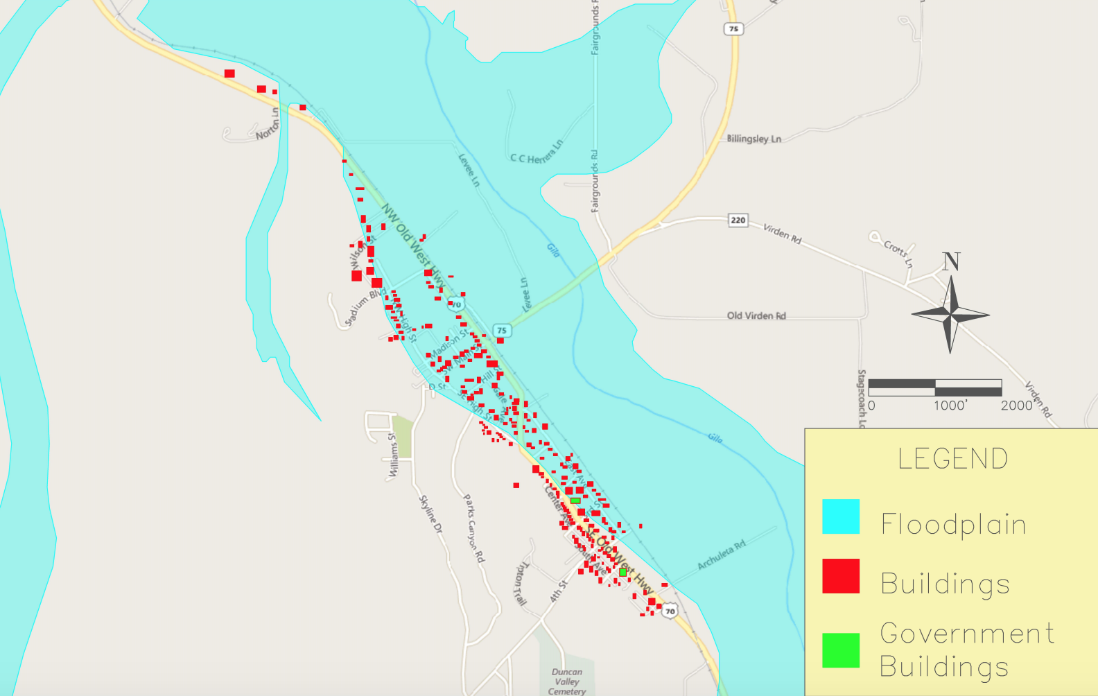
Figure 2: Map of Duncan, AZ, Floodplain Zone [3]
Notes:
Slide: Ashley *Government Buildings- one is a town home and one is the fire department*

Slide 4
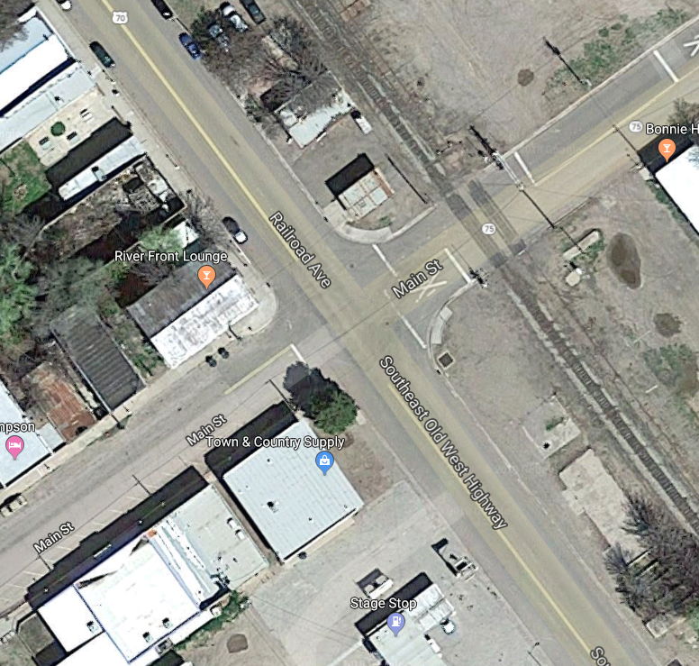
Crash Data Analysis
Table 1: 2017 ADOT Data Report [1] [2].
Town | Number of Crashes |  |  |  | Number of People |  | Alcohol Related
 | Total | Fatal | Injury | Property Damage Only | Killed | Injured | Crashes | Killed | Injured
Duncan | 3 | 1 | 1 | 1 | 1 | 2 | 1 | 1 | 0
Figure 3: Map of Duncan, AZ, Intersection of
Main Street (SR 75) and Railroad Ave (SR 70)
Notes:
Slide: Ashley

Slide 5
Traffic Analysis
Table 2: 2017 ADOT data report [1] [2].
AADT Report
Route | BMP¹ | EMP² | AADT³
SR 75 | 378.92 | 379.46 | 2,792
US 70 | 349.48 | 378.48 | 1056
 | 378.48 | 378.91 | 1567
 | 378.91 | 379.48 | 3470
Crash Data
County | Number of Crashes
Greenlee | 84
Notes:
Slide: Ashley

Slide 6
Traffic Characteristics
Table 3: 2017 ADOT Data Report [1] [2].
Terms | Value
Average Annual Daily Traffic (AADT) 2017 | 2184 Vehicles
Growth Factor | 1%
K Factor- the proportion of AADT occurring in 1 hour | 9%
D Factor-% of traffic moving in the peak travel direction | 59%
Average Annual Daily Traffic- Single Trucks | 129 Vehicles
Average Annual Daily Traffic- Combo Trucks | 85 Vehicles
T Factor- % of trucks in 1 hour | 10%
Future Annual Average Daily Traffic | 2925 Vehicles
Table 4: 2017 ADOT Data Report [1] [2].
Terms | Criteria
Existing Speed | 45 miles per hour
Estimated Free Flow Speed | 39.5 miles per hour
Design Speed | 60 miles per hour
Lanes | 2
Slopes of Elevated Highway | 4 Horizontal: 1 Vertical
Shoulder Length | 6 feet on each side
Current LOS | A
Notes:
Slide: Ashley- Explain design speed vs posted speed

Slide 7
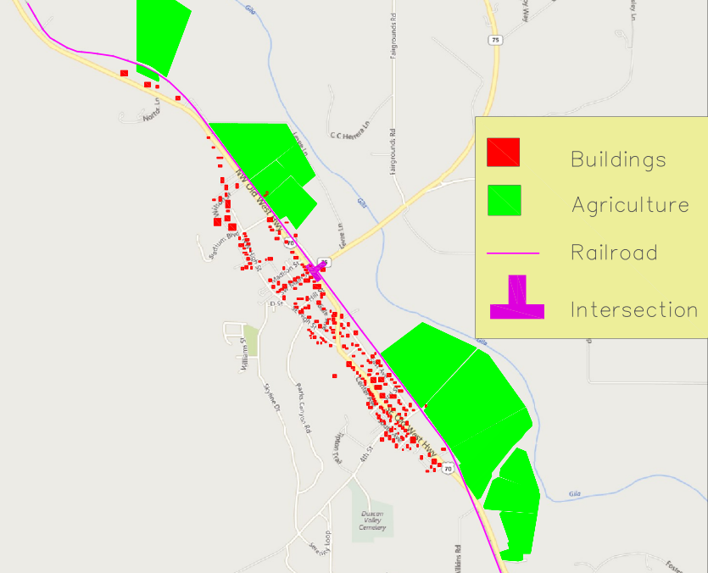
Existing Features
Figure 4: Map of Duncan, AZ Existing Features
Notes:
Slide: Ashley * need to turn these into things into items on a map of our site*

Slide 8
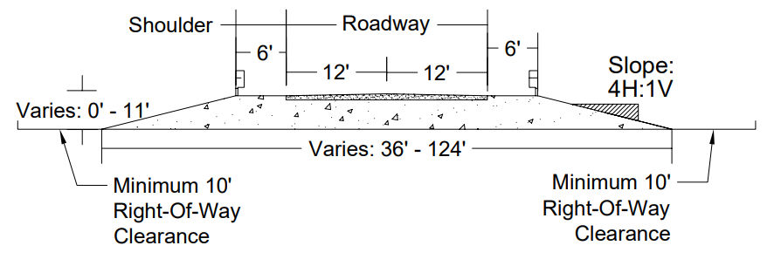
Corridor Design
Corridor Design
Turning Lane (12’) | 12 feet
Slope (2 sides) | 51 feet
Lane Width (2 lanes) | 24 feet
Shoulder Width (6’ each side) | 12 feet
Total Average Width | 99 feet
Figure 5: Typical Cross Sections of the Levee Design
Notes:
`Slide: Ashley
-talk about where these number came from*

Slide 9
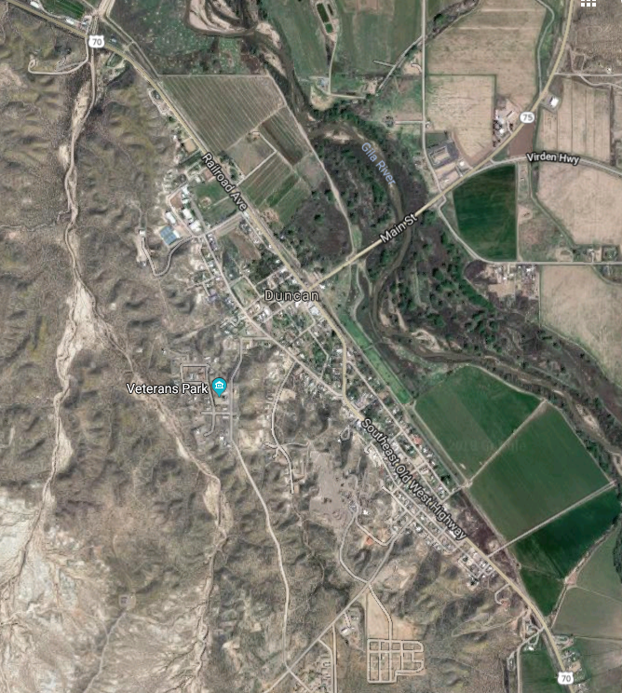

Levee Road Alignment Options
Alignment Option 1: Raising Current Highway
Alignment Option 2: Running Along Agricultural Dike
Alignment Option 3: Running Parallel to Railroad on Agricultural Land
Legend:
Corridor
Existing Highway
Gila River
Notes:
Slide: Ashley

Slide 10
Alignment Option 1: Raising Current Highway
  Max Corridor Width- 108 feet
  LOS A
  Design Speed of 60 mph
Legend:
Corridor
Existing Highway
Gila River
Figure 6: Schematic for Horizontal Alignment Option 1 [4]
Notes:
Slide: Morty

Slide 11
Highway Capacity Software (HCS)
Alignment Option 1: Raising Current Highway
Table 5: HCS Input Data for Alignment Option 1 [5]
Input Data
Term | Value
Highway Class | Class 2
Shoulder Width | 6 feet
Lane Width | 12 feet
Terrain Type | Level
Peak- Hour Factor, PHF | 0.88
% No-Passing Zone | 100
Access Points/Miles | 14
Two-Way Hourly Volume, V | 105 vehicles/hr
Directional Split | 60/40 %
Level of Service (LOS): A
Design Speed of 60 mph- achieved
Percent Time Spent Following: 34.4%
Results
Notes:
Slide: Morty

Slide 12
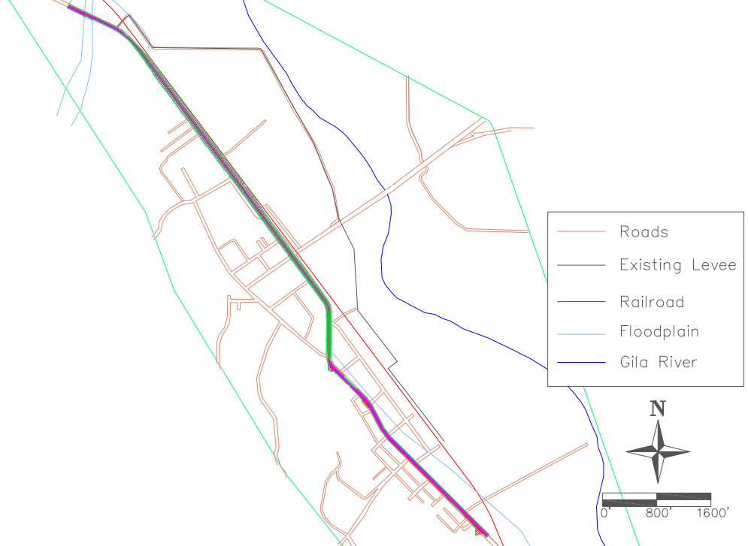
Alignment Option 1: Raising Current Highway- Horizontal Alignment
Levee Length:
  1.30 Miles
Cut Material:
  1,300 Cubic yards
Fill Material:
  85,300 Cubic yards
Removal of 22 Homes
Figure 7: Alignment Option 1- Horizontal Alignment
Notes:
Slide: Morty

Slide 13
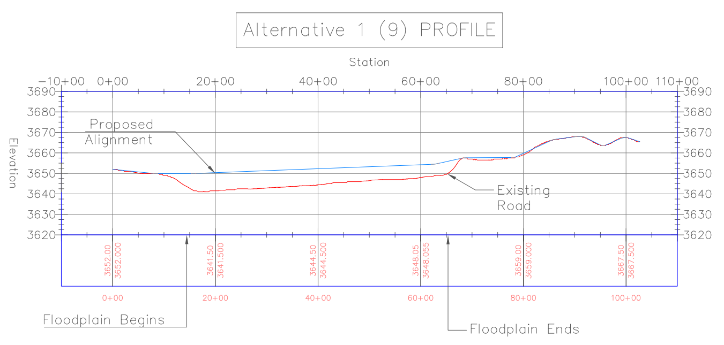
Alignment Option 1: Raising Current Highway- Vertical Alignment
Maximum Existing Elevation:
3669'
Minimum Existing Elevation:
3641'
Levee Elevation:
3650' -3655'
Figure 8: Alignment Option 1- Vertical Alignment
Notes:
Slide: Morty

Slide 14
Alignment Option 2: Running Along Agricultural Dike
  Max Corridor Width- 108 feet
  LOS A
  Design Speed of 60 mph
Legend:
Corridor
Existing Highway
Gila River
Figure 9: Schematic for Horizontal Alignment Option 2 [4]
Notes:
Slide: Morty

Slide 15
Highway Capacity Software (HCS)
Alignment Option 2: Running Along Agricultural Dike
Table 6: HCS Input Data for Alignment Option 2 [5]
Input Data
Term | Value
Highway Class | Class 2
Shoulder Width | 6 feet
Lane Width | 12 feet
Terrain Type | Level
Peak- Hour Factor, PHF | 0.88
% No-Passing Zone | 100
Access Points/Miles | 3
Two-Way Hourly Volume, V | 105 vehicles/hr.
Directional Split | 60/40 %
Level of Service (LOS): A
Design Speed of 60 mph- achieved
Percent Time Spent Following: 34.4%
Results
Notes:
Slide: Morty

Slide 16
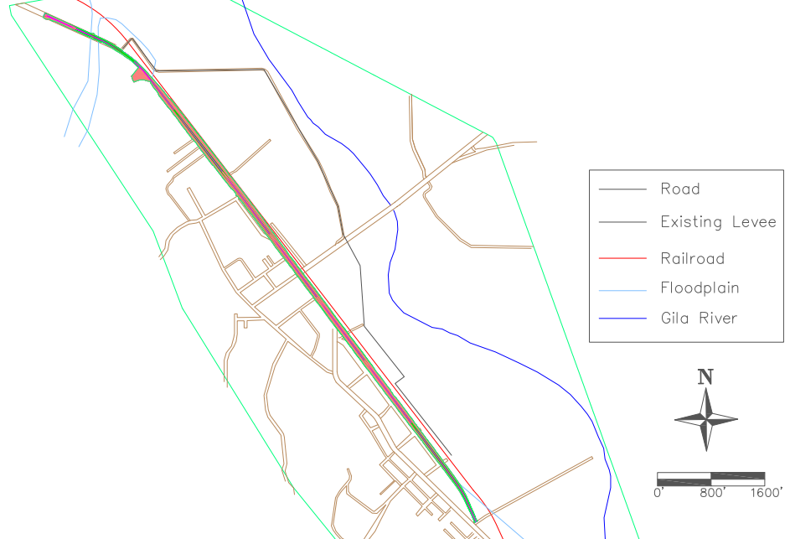
Alignment Option 2: Running Along Agricultural Dike- Horizontal Alignment
Levee Length:​
1.91 Miles​
Cut Material: ​
4,500 Cubic yards​
​
Fill Material: ​
138,000 Cubic yards
Removal of 41 Homes​
Figure 10: Alignment Option 2- Horizontal Alignment
Notes:
Slide: Morty

Slide 17
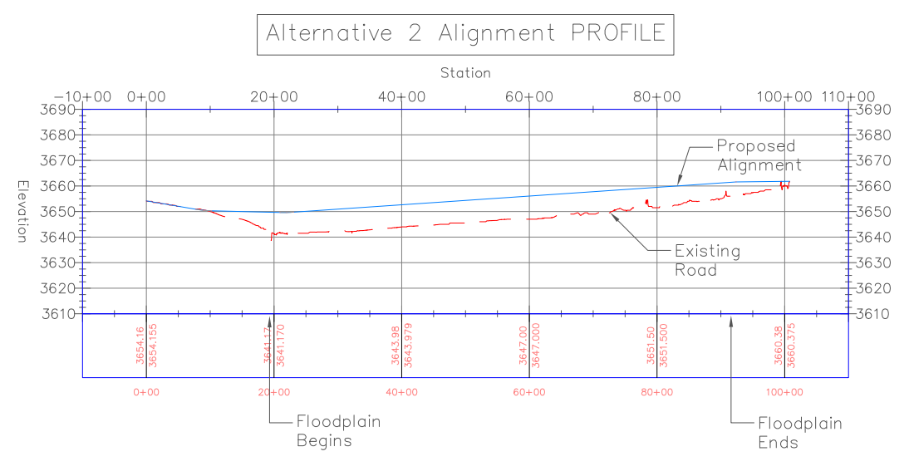
Alignment Option 2: Running Along Agricultural Dike- Vertical Alignment
Maximum Existing Elevation: ​
3661'
​
Minimum Existing Elevation: ​
3641'
Levee Elevation:
3650'-3661'
Figure 11: Alignment Option 2- Vertical Alignment
Notes:
Slide: Morty

Slide 18
Alignment Option 3: Running Parallel to Railroad on Agricultural
  Max Corridor Width- 124 feet
  LOS A
  Design Speed of 60
Legend:
Corridor
Existing Highway
Gila River
Figure 12: Schematic for Horizontal Alignment Option 3 [4]
Notes:
Slide: Morty

Slide 19
Highway Capacity Software (HCS)
Alignment Option 3: Running Parallel to Railroad on Agricultural
Table 7: HCS Input Data for Alignment Option 3 [5]
Input Data
Term | Value
Highway Class | Class 2
Shoulder Width | 6 feet
Lane Width | 12 feet
Terrain Type | Level
Peak- Hour Factor, PHF | 0.88
% No-Passing Zone | 100
Access Points/Miles | 3
Two-Way Hourly Volume, V | 105 vehicles/hr
Directional Split | 60/40 %
Level of Service (LOS): A
Design Speed of 60 mph- achieved
Percent Time Spent Following: 34.4%
Results
Notes:
Slide: Morty

Slide 20
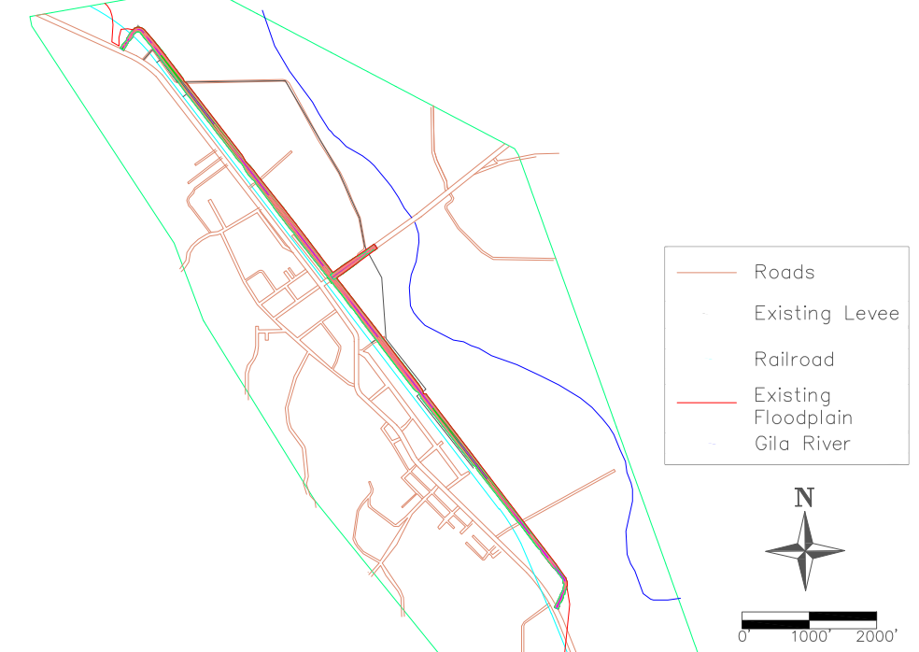
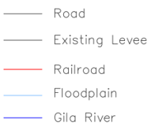
Alignment Option 3: Running Parallel to Railroad on Agricultural- Horizontal Alignment
Levee Length:​​
2.12 Miles​​
​
Cut Material: ​​
1,300 Cubic yards​​
​​
Fill Material: ​​
171,000
Cubic yards
Elevated Intersection with SR 75 at Elevation 3656'
Take over approximately 26 acres of land
Figure 13: Alignment Option 3- Horizontal Alignment
Notes:
Slide: Leslie
- At the sharp term the speed drops down to 20mph and has a radius of 176

Slide 21
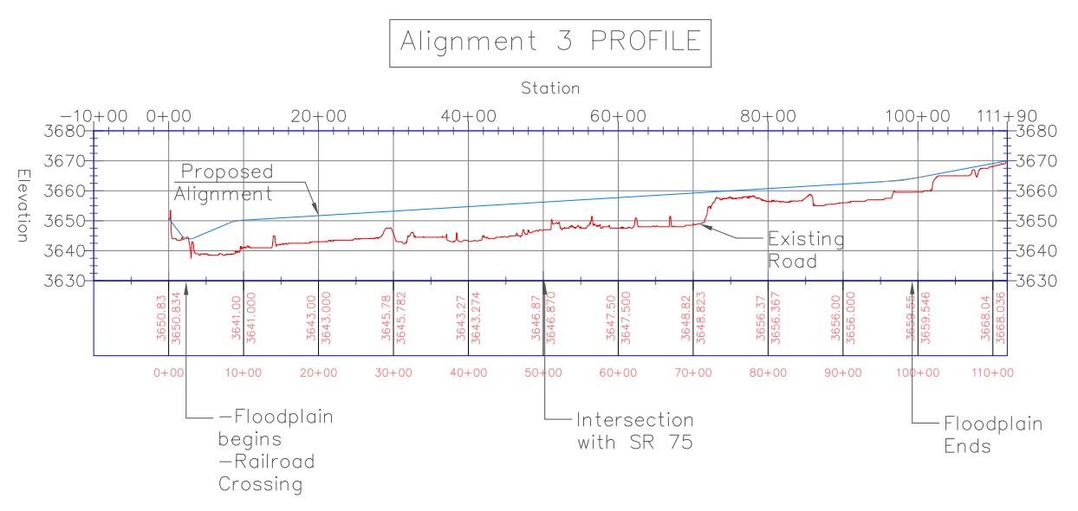
Alignment Option 3: Running Parallel to Railroad on Agricultural- Vertical Alignment
Maximum Existing Elevation: ​​
3670'​
​​
Minimum Existing Elevation: ​​
3638'
Intersection Elevation: 3655.7'
Levee Elevation:
3650'- 3670'
Figure 14: Alignment Option 3- Vertical Alignment
Notes:
Slide: Leslie

Slide 22
Cost Assessment- Land Value Assessment
Table 8: Land Value Assessment Individual Costs [6]
 | Cost
Range of Housing Cost | $1,400-193,000
Cost Per Acre of Agricultural Land | $13,000
Table 9: Land Value Assessment Total Costs [6]
Design Alternative | Cost Per Unit | Total Cost
Alternative 1: Along Existing Highway | 22 Homes | $1,430,400
Alternative 2: Along Agricultural Dike | 41 Homes | $2,416,400
Alternative 3: Along Agricultural Land | Approximately 26 Acres of Land | $338,000
Notes:
Slide: Leslie
* For 22: talk about where it came from on the slide
Average (do to varies)
For townhall and fire department (look up commerical values and go from there) townhall seems like to much

Slide 23
Cost Assessment- Quantity Take-off
Table 10: Design Individual Costs [7]
 | Cost
Cut | $9 / Cubic yard
Fill | $18 / Cubic yard
Levee | $1,922 / Linear Foot
Table 11: Design Parameters [7]
 | Cut (yd³) | Fill (yd³) | Levee Length (ft)
Alternative #1 | 1,229 | 85,293 | 6,800
Alternative #2 | 4,450 | 138,257 | 10,077
Alternative #3 | 1,240 | 170,939 | 11,190
Notes:
Slide: Leslie
*Need to add equations to this slide* (Also need to note where we are getting these numbers from.
$18 yard for engineering designed fill not normal fill

Slide 24
Cost Assessment- Alternatives Total Cost
Table 12: Alternatives Total Cost
 | Alignment #1 | Alignment #2 | Alignment #3
Material Cut Cost | $11,054 | $40,042 | $11,159
Material Fill Cost | $1,535,261 | $2,488,615 | $3,076,893
Land Value | $1,430,400 | $2,416,400 | $338,000
Levee Length Cost | $13,069,600 | $19,367,885 | $21,507655
20-year Maintenance Cost | $1,166,638 | $1,145,109 | $1,271,619
20% Feasibility Blow-up | $17,210,315 | $25,458,049 | $26,205,326
Total Cost | $20,650,000 | $30,550,000 | $31,500,000
Notes:
Slide Leslie *Need to add Road Maintance for 20 years*,
Once pavement deteriorates, it costs $300,000 per lane mile to mill down and replace the asphalt surface.

Slide 25
Final Summary Table
Table 13: Final Summary Table
Value | Alignment 1 | Alignment 2 | Alignment 3
Total Cost | $28,650,000 | $30,550,000 | $31,500,000
Agricultural Land | N/A | N/A | Approx. 26 Acres
Property Taken (Acres) | 23.6 | 23.2 | 25.7
Houses Taken | 22 | 41 | N/A
Properties Taken | 30 | 51 | 30
Divides the City | Yes | Yes | No
Notes:
Slide: Leslie

Slide 26
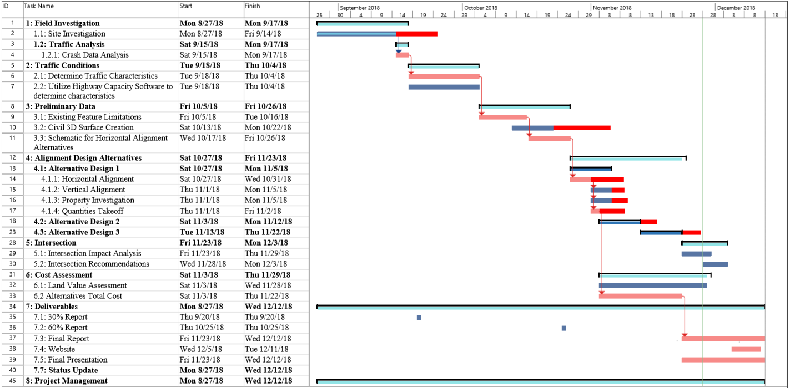
Schedule
Figure 15: Schedule of Project
Notes:
Slide: Leslie
-talk about how the deep red is our new extended times

Slide 27
Engineering Cost Hour Matrix
Proposed Matrix
Task Name | Sr. Engineer | Prof. Engineer | EIT (4 Combined) | Drafter/Tech | Admin-istrator | Task Total
1: Field Investigation | 4 | 24 | 80 | 0 | 0 | 108
2: Traffic Conditions | 2 | 7 | 48 | 0 | 0 | 57
3: Preliminary Data | 3 | 10 | 64 | 13 | 0 | 90
4: Alignment Design Alternatives | 7 | 22 | 144 | 29 | 12 | 214
5: Intersection | 2 | 5 | 32 | 7 | 2 | 48
6: Cost Assessment | 2 | 5 | 32 | 0 | 8 | 47
7: Deliverables | 7 | 22 | 144 | 0 | 20 | 193
8: Meetings | 2 | 5 | 34 | 0 | 7 | 48
Total Hours | 29 | 100 | 578 | 49 | 49 | 805
Final Matrix
Task Name | Sr. Engineer | Prof. Engineer | EIT (3 Combined) | Drafter/Tech | Admin-istrator | Task Total
1: Field Investigation | 0 | 3 | 9 | 0 | 0 | 12
2: Traffic Conditions | 2 | 5 | 36 | 0 | 0 | 43
3: Preliminary Data | 9 | 27 | 180 | 10 | 0 | 226
4: Alignment Design Alternatives | 5 | 16 | 108 | 22 | 12 | 163
5: Intersection | 0 | 1 | 6 | 1 | 2 | 10
6: Cost Assessment | 1 | 4 | 24 | 0 | 8 | 37
7: Deliverables | 6 | 18 | 120 | 0 | 20 | 164
8: Meetings | 1 | 4 | 26 | 0 | 5.1 | 36
Total Hours | 25 | 78 | 509 | 33 | 47 | 691
Table 14: Proposed Cost Hour Matrix
Table 15: Final Cost Hour Matrix
Notes:
Slide: Leslie

Slide 28
Cost of Engineering Work
Proposed Cost
Rate Table
Staff | Pay Rate ($/hr.) | Multiplier |  | Billing Rate ($/hr.) | Hours |  | Cost ($)
Sr. Engineer | 60 | 3 |  | 180 | 29 |  | $5,220.00
Prof. Engineer | 40 | 2.5 |  | 100 | 100 |  | $10,000.00
EIT | 25 | 2.5 |  | 62.5 | 578 |  | $36,125.00
Drafter/Tech | 25 | 2 |  | 50 | 49 |  | $2,450.00
Administrator | 20 | 2 |  | 40 | 49 |  | $1,960.00
ADOT Coordinator | 30 | 2 |  | 60 | 20 |  | $1,200.00
OTHER EXPENSES
 | Cost ($/mi.) |  | Trips |  |  | Miles
Travel | 0.7 |  | 2 |  |  | 600 | $840.00
 | Cost ($/night) |  |  |  |  | Rooms
Hotel | 150 |  | - |  |  | 6 | $900.00
 |  |  |  |  |  | Total Cost | $58,695.00
Final Cost
Rate Table
Staff | Pay Rate ($/hr.) | Multiplier | Billing Rate ($/hr.) | Hours | Cost ($)
Sr. Engineer | 60 | 3 | 180 | 25 | $4,576.50
Prof. Engineer | 40 | 2.5 | 100 | 78 | $7,762.50
EIT | 25 | 2.5 | 62.5 | 509 | $31,781.25
Drafter/Tech | 25 | 2 | 50 | 33 | $1,640.00
Administrator | 20 | 2 | 40 | 47 | $1,884.00
ADOT Coordinator | 30 | 2 | 60 | 20 | $1,200.00
 |  |  |  | Total Cost | $48,844.25
Table 16: Proposed Cost of Engineering Work
Table 17: Final Cost of Engineering Work
Notes:
Slide: Leslie

Slide 29
References
[1] A. Smith, C. Bitsoie, . S. Schumacher and T. Whelan, "Base Flood," Duncan Flood Analysis Capstone Team, Flagstaff, 2017.
[2] ADOT, "AADT Report Multimodal Planning," 2017. [Online]. Available: https://www.azdot.gov/docs/default-source/planning/2017-aadt-publication-states-routes.pdf?sfvrsn=6. [Accessed 2018 30 Aug].
■[3] ”FEMA Flood Map Service Center," FEMA, 2016. [Online]. Available: https://msc.fema.gov/portal [Accessed 22 April. 2018].
[3] ADOT, "2017 Motor Vehicle Crash Facts for the State of Arizona," 2017. [Online]. Available: https://www.azdot.gov/docs/default-source/mvd-services/2017-crash-facts.pdf?sfvrsn=2. [Accessed 30 Aug 2018].
[4] “Google Maps- Duncan AZ.” Google Maps, Google, www.google.com/maps.
[5] HCM 2010 : Highway Capacity Manual. Washington, D.C. :Transportation Research Board, 2010. Print.
[6] “Real Estate, Apartments, Mortgages & Home Values.” Mortgage Learning Center, www.zillow.com/.
[7] “Http://Ljournal.ru/Wp-Content/Uploads/2017/03/a-2017-023.Pdf.” 2017, doi:10.18411/a-2017-023.
Notes:
Slide: Leslie

Slide 30
Any Questions?
Notes:
Slide: Leslie

